Slide 1
UNIT 7 – Software Development Life Cycle
Week [03] – Software Lifecycles (Part 2)

Slide 2
Academic Integrity Policy
Are you aware that following are not accepted in ESOFT
Plagiarism - using work and ideas of other individuals intentionally or unintentionally
Collusion - preparing individual assignments together and submitting similar work for assessment.
Cheating - obtaining or giving assistance during the course of an examination or assessment without approval
Falsification – providing fabricated information or making use of such materials

Slide 3
Learning Outcomes
By the end of this unit students will be able to,
LO1 Describe different software development lifecycles
LO2 Explain the importance of a feasibility study
LO3 Undertake a software development lifecycle
LO4 Discuss the suitability of software behavioural design techniques

Slide 4
Recommended Books
Dennis, A. and Haley, W. (2009) Systems Analysis and Design. John Wiley & Sons Ltd.
Lejk, M. and Deeks, D. (2002) An Introduction to System Analysis Techniques. 2nd Ed. Addison-Wesley.
Murch, R. (2012) The Software Development Lifecycle: A Complete Guide. Kindle.
Smart, J. F. (2014) BDD in Action: Behavior-driven development for the whole software lifecycle. Manning.

Slide 5
Prototyping Model

Slide 6
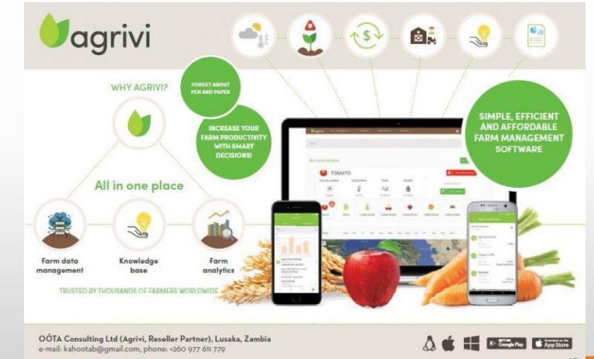
Farming Software

Slide 7
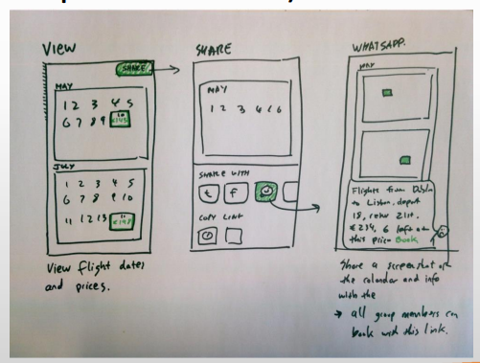
Example
Explain Whatsapp (before implementation) to a traditional farmer

Slide 8
Prototype Model
Instead of freezing the requirements before coding or design, a prototype is built to clearly understand the requirements.
This prototype is built based on the current requirements.
Through examining this prototype, the client gets a better understanding of the features of the final product.
Requirements may be changed with the client feedback on the prototype.

Slide 9
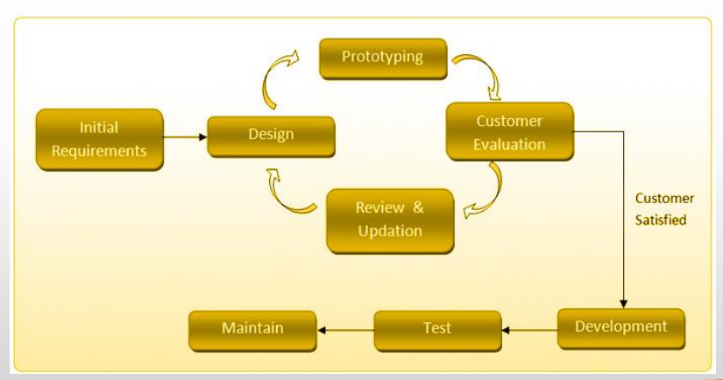
Prototype Model

Slide 10
Prototyping Model - Strengths
Ability to clarify user’s expectations for the system to be developed
Prototype stimulates awareness of additional needed functionality
Better user satisfaction
Early user feedback

Slide 11
Prototyping Model - Weaknesses
Scope Creep - The system scope may expand beyond original plans.
Overall maintainability may be overlooked.
The customer may want the prototype be delivered.
Process may continue forever.

Slide 12
When to Use Prototyping
Requirements are unstable or have to be clarified
Many user interfaces
New technology
New, original development
Developers are not familiar with the technical and development tool

Slide 13

Question
A company is developing an advanced version of their current software available in the market, what model approach would they prefer ?

Slide 14
SDLC Model Selection
Is based on
1. Customer
Budget
Timeline
Existing software/ OSS
Client experience and technical knowledge
Flexibility
2. Product
Complexity and risk level
New / experienced technology
Availability of tools
Requirements Clarity
3. Developer experience and technical knowledge ……..

Slide 15
Spiral Model

Slide 16
Spiral Model
Meta Model - combines iterative and prototype development with the systematic, controlled aspects of the waterfall model.
Allows for incremental releases
Introduced by Barry Boehm in 1986.
Allows elements of the product to be added in when they become available or known.
Emphasizes on risk management

Slide 17
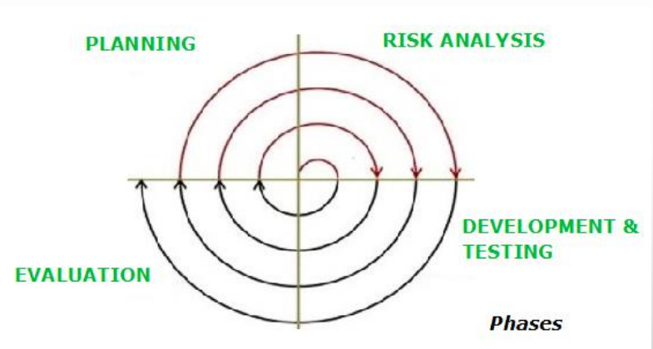
Spiral Model

Slide 18
Spiral Model
Quadrant 1: Planning
Determine objectives, alternatives, and constraints.
Quadrant 2: Risk Analysis
Evaluate alternatives, identify, resolve risks.
Quadrant 3: Development & Test
Develop, verify, next-level product.
Quadrant 4: Evaluation
Analyse feedback and plan next phases.

Slide 19
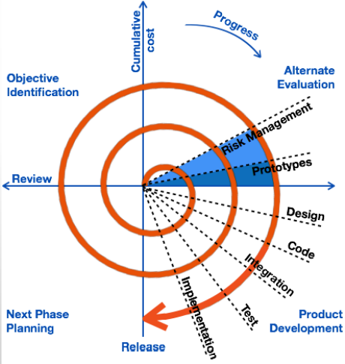
Spiral Model

Slide 20

Question
Which of the following models will not be able to give the desired outcome if user’s participation is not involved?
Waterfall
Spiral
Prototyping

Slide 21
Spiral Model - Strengths
Focus on risk analysis.
Good for large and mission critical projects
A working software is produced early
The design does not have to be perfect
Early and frequent feedback from users
Cumulative costs assessed frequently

Slide 22
Spiral Model - Weaknesses
Can be a costly model to use.
Risk analysis requires expertise.
Success is highly dependent on the risk analysis phase.
Doesn’t work well for smaller projects.

Slide 23
When to use Spiral Model
For medium to high-risk projects
New technology to be used
Complex, constantly changing and continuous Requirements
Significant changes are expected (research and exploration)
Users are unsure of their needs

Slide 24
Question
Which of the following life cycle model can be chosen if the development team has less experience on similar projects?
a) Spiral
b) Waterfall
c) Iterative

Slide 25
Activity
" Mindful " is a program that will be used to control and monitor the covid epidemic crisis. Each Medical Officer of Health (MOH) in each suburb is required to use this system. In 2023, many users and authorities will utilize this as their primary application. Because several members of the project team have prior experience working on projects in the United States, they have a clear set of requirements. They also have a one-year deadline to complete this.

Slide 26
Lesson Summary
Prototyping Model
Prototyping Model – Strengths
Prototyping Model – Weaknesses
Spiral Model
Spiral Model – Strengths
Spiral Model - Weaknesses

